Slide 1

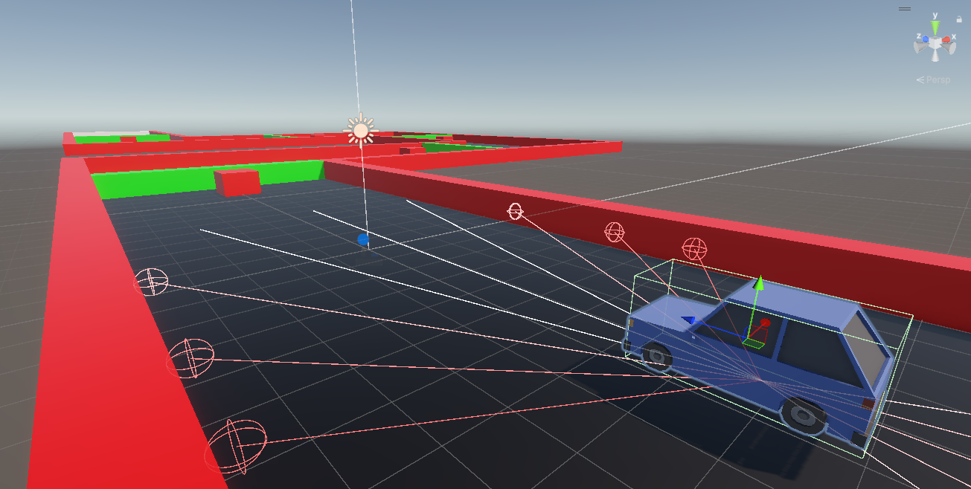
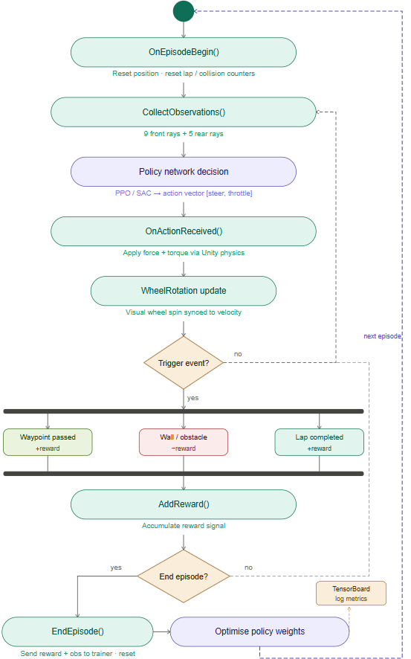
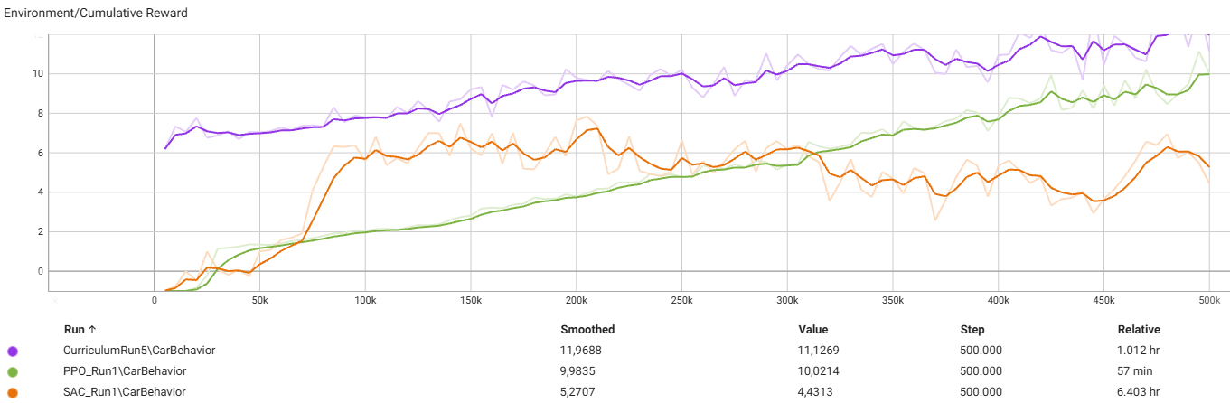
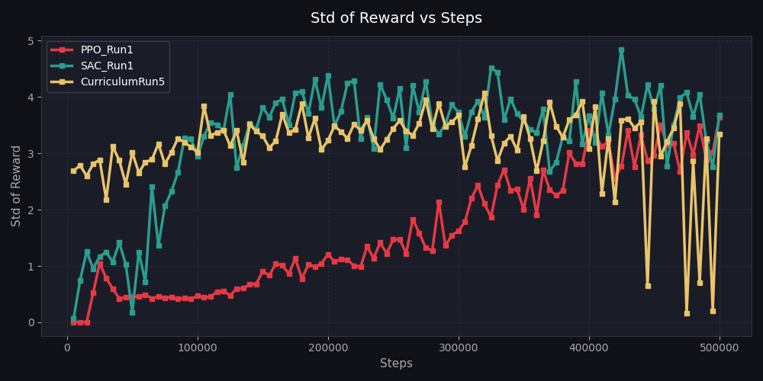
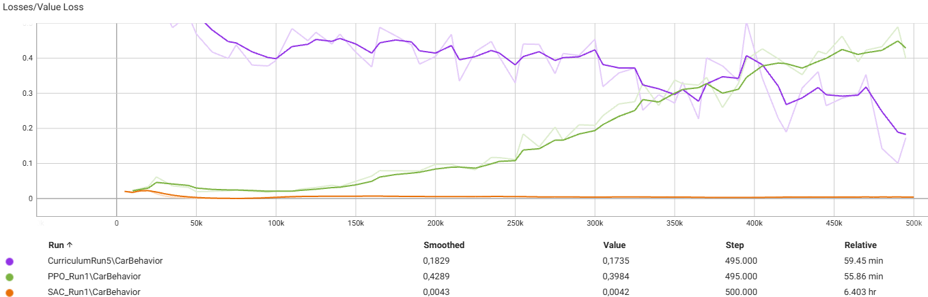
University of Turkish Aeronautical Association
Autonomous Car with Reinforcement Learning
Mehmet Efe KAPISIZ
Prof. Dr. Ziya KARAKAYA
Department of Computer Engineering, CENG 496
PROJECT DESCRIPTION
Rule-based autonomous vehicle systems often struggle to adapt to dynamic environments. Reinforcement Learning offers a robust alternative by enabling agents to derive adaptive driving policies through iterative interaction. By leveraging the Unity engine and ML Agents Toolkit, this project develops an autonomous navigation policy.
OBJECTIVES
The primary objective of this project is to develop an autonomous navigation policy capable of traversing dynamic environments. The project employs a Curriculum Learning pipeline to scaffold obstacle difficulty progressively. Within this structure, we evaluate Proximal Policy Optimization (PPO) against Soft Actor-Critic (SAC) to identify the optimal training framework. Our central hypothesis is that PPO will yield better performance compared to SAC.
SYSTEM DESIGN AND METHODOLOGY
Agent Architecture
Ray perception sensors (LiDAR) and an 8-dimensional continuous input vector observe the environment. The model outputs a 2 dimensional continuous action vector for throttle, brake, and steering control.
Reward Function
Progress: +Δd × 0.1 per decision step, +0.3 per waypoint reached, +2.0 for crossing the finish line
Penalties: −0.5 for wall collision, −1.0 for obstacle collision
Neural Network & Infrastructure
The agent utilizes a 3-layer feedforward network (256 units/layer) with input normalization and no recurrent architecture, relying solely on the instantaneous observation vector. Training is conducted via the Python ML-Agents library through a local gRPC interface. Models are exported as ONNX and metrics logged to TensorBoard.
RESULTS AND CONCLUSION
PPO demonstrated superior performance over SAC in this setting; while SAC’s off-policy design prioritizes sample efficiency, PPO’s clipped objective function proved essential for maintaining gradient stability during high-variance physical interactions.
The successful implementation of a staged Curriculum Learning pipeline, combined with PPO, enabled the agent to achieve robust, generalizable navigation in dynamic environments. This study establishes that policy stability and incremental training stages are foundational requirements for developing reliable autonomous vehicles in unpredictable, stochastic scenarios.
Training Strategy | Peak Mean Reward | Test Performance
Curriculum PPO | 13.31 | Full track
Standalone PPO | 11.14 | ~50% track
Standalone SAC | 7.83 | Rarely past Waypoint 3

